Slide 1
Physical Web meets Web Bluetooth
RC Lego car project

Slide 2
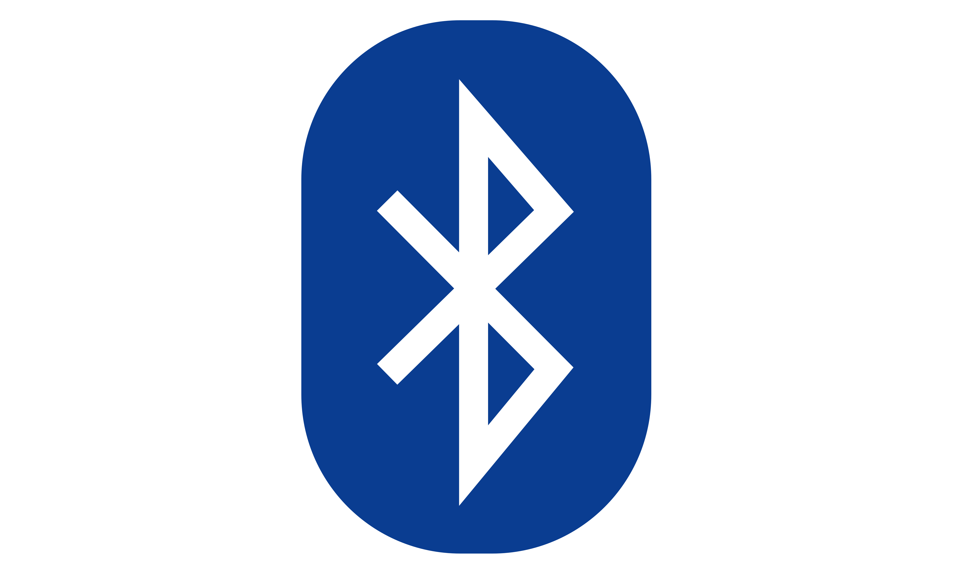
Bluetooth Background

Slide 3
General informations
Bluetooth background
developed 1990
standard for wireless device to device communication
current version: v4.2
„normal“ Bluetooth connection oriented (pairing)
Bluetooth Low Energy (since v4.0) ad hoc communication possible

Slide 4
Bluetooth Profiles
Bluetooth Background
Interface definitions. Samples are:
A2DP (Advanced Audio Distribution Profile) - audio streaming
OBEX-FTP - file transfer
HID - Human Interface Device Profile
PAN - Personal Area Network Profile
GATT - Generic Attribute Profile

Slide 5
Bluetooth Low Energy
Bluetooth Background
Since Bluetooth v4.0
Optional (v4.0 devices don’t have to support BLE)
Physical wireless communication is different for Bluetooth and BLE so most Bluetooth chips have two circuits
Slaves send advertisement packages periodically
only GATT profiles supported
Android: since Version 4.3, iOS: since Version 5

Slide 6
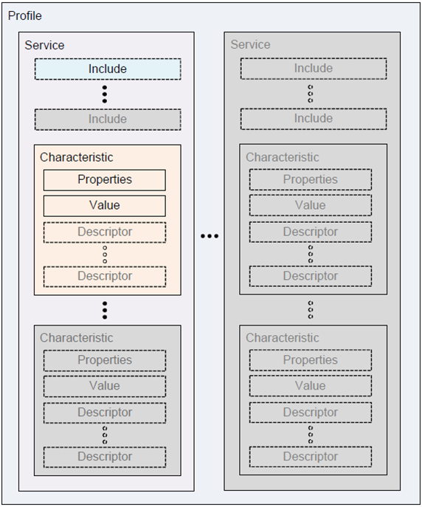
Bluetooth GATT Profile
Bluetooth Background
A device implementing the GATT profile provides:
1..n services [UID]
with 1..n characteristics [UID]
read/write/readWrite
Represents a value
There are a number of standardized services (standardized UID):
Battery Service
Blood Preassure
…

Slide 7
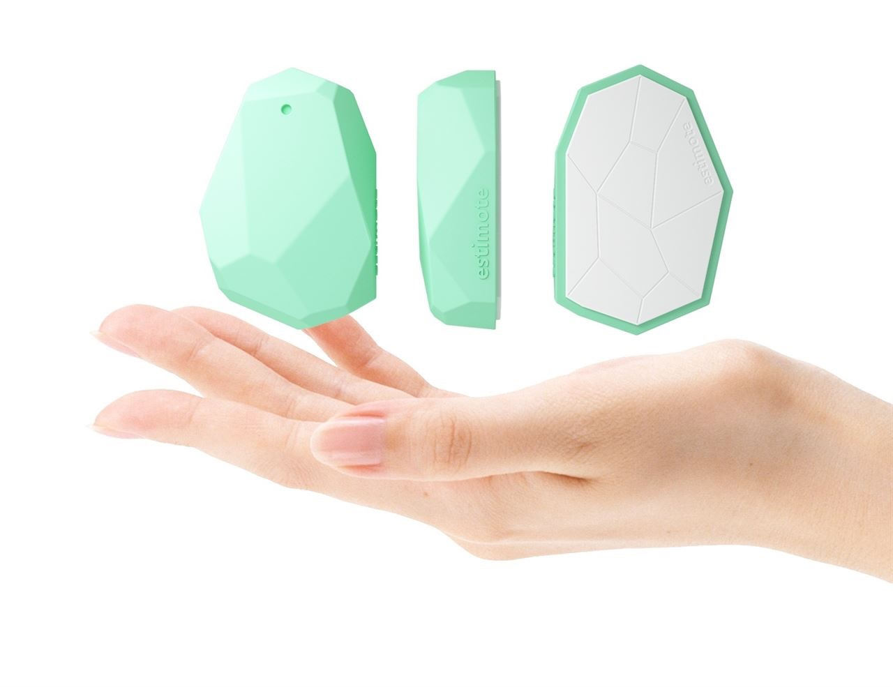
Bluetooth Beacons
Bluetooth Background
Based on Bluetooth Low Energy
Continuous advertisement package broadcasting
Protocols
iBeacon (Apple): UID advertisement
AltBeacon: UID advertisement
URIBeacon: URL advertisement
Eddystone (Google): UID, URL or TLM advertisement
Clients use the beacons to react to their presence and / or data

Slide 8

Physical Web
Bluetooth Background
Initiated by Google
Idea: Interaction with a nearby device should be possible without installing anything on the client device
Based on Eddystone Beacons (currently, the idea is independent from that)
Integration in Android devices is currently rolling out (newest Google Play Services -> Nearby)
Usable with the Physical Web app (Android) or Google Chrome (iOS)

Slide 9


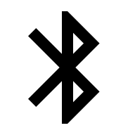
Web Bluetooth
+

Slide 10
Cornerstones
Web Bluetooth
Standard for interacting with BLE devices from a web page via JavaScript (WebApp)
Developed as a community team managed from the W3C
No standard yet and no plans in sight
Many years will pass until WebBluetooth is a standard and integrated in all common browsers and platforms

Slide 11
Current progress
Web Bluetooth
Google has done a first reference implementation in Chrome/Chromium
Work in progress: API can change any time
Only a hand full of platforms supported (27.06.16: Android, Chrome OS, Linux, planned: Windows, MacOS, iOS: when Apple adds WebBluetooth to its WebKit)
Microsoft is thinking about an implementation („under consideration“)
Apple didn’t release any statement regarding WebBluetooth yet

Slide 12
Security
Web Bluetooth
Protection against abusing this API is the primary goal of the specification
Requirement: User has to actively interact with the device to provide a web application access to a BLE device
The web app can’t see all BLE devices. It only gets access to the device the user selected (so that location determination isn’t possible using this API)
API only can be used having a secure connection (https)

Slide 13
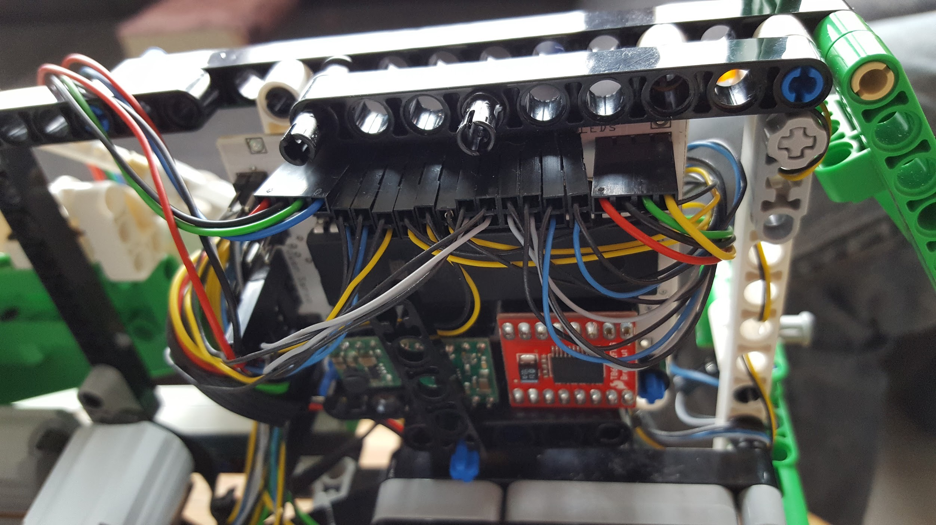
RC Lego Car Project

Slide 14
Intention
RC Lego Car Project
Combine WebBluetooth with the ideas from the Physical Web
Controlling a device
without installing an app
without having the device to be connected to the internet
using state of the art web technology like offline caching

Slide 15
Why Lego?
RC Lego Car Project
First try: Switching a LED on and off
BLE Slave: Raspberry Pi (NodeJS)
Not very impressive => the idea to control a Lego Technic car has been born
Project mutated from a web to a electronic project

Slide 16
Variants
RC Lego Car Projekt
Over the course of the project different variants were implemented
BLE Slave (Car logic):
Raspberry Pi (NodeJS)
Intel Edison (NodeJS)
RedBear Duo (Arduino) and ATMega32 (C)
BLE Master (Remote control)
Android App (Java, Android Framework)
Android Wear App (Java, Android Framework)
Tizen Wear App (HTML 5, TAU [Tizen Advanced UI])
Web App (HTML 5, AngularJS 2)

Slide 17
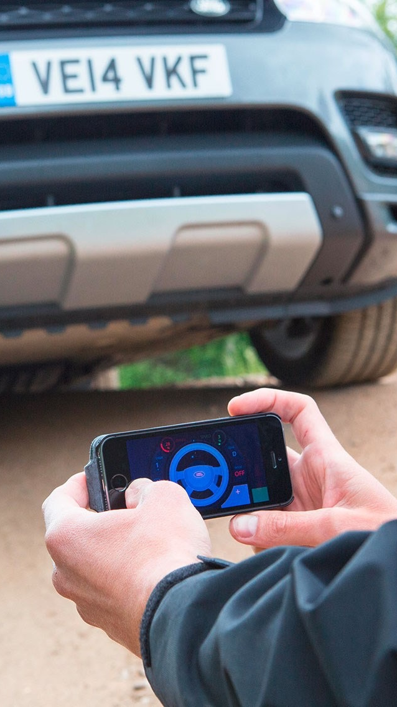
Remote control
RC Lego Car Project

Slide 18
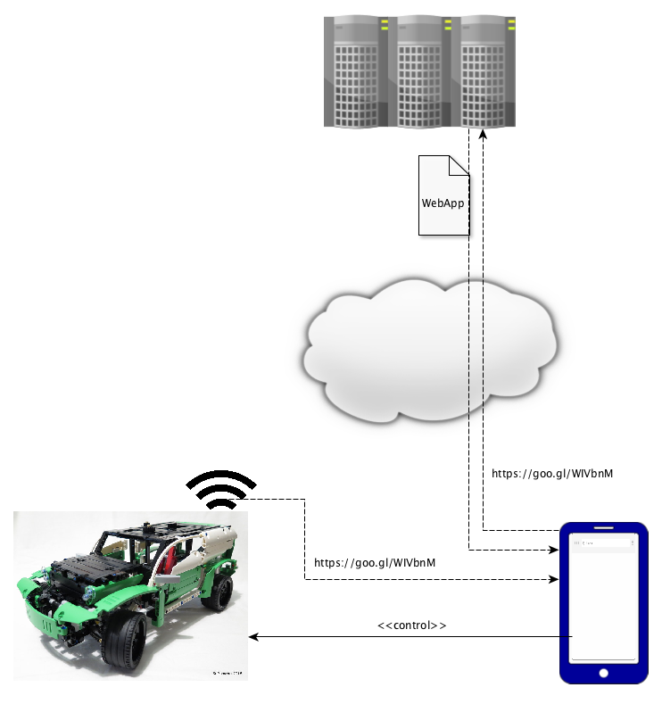
Connection
RC Lego Car Project - Remote control

Slide 19
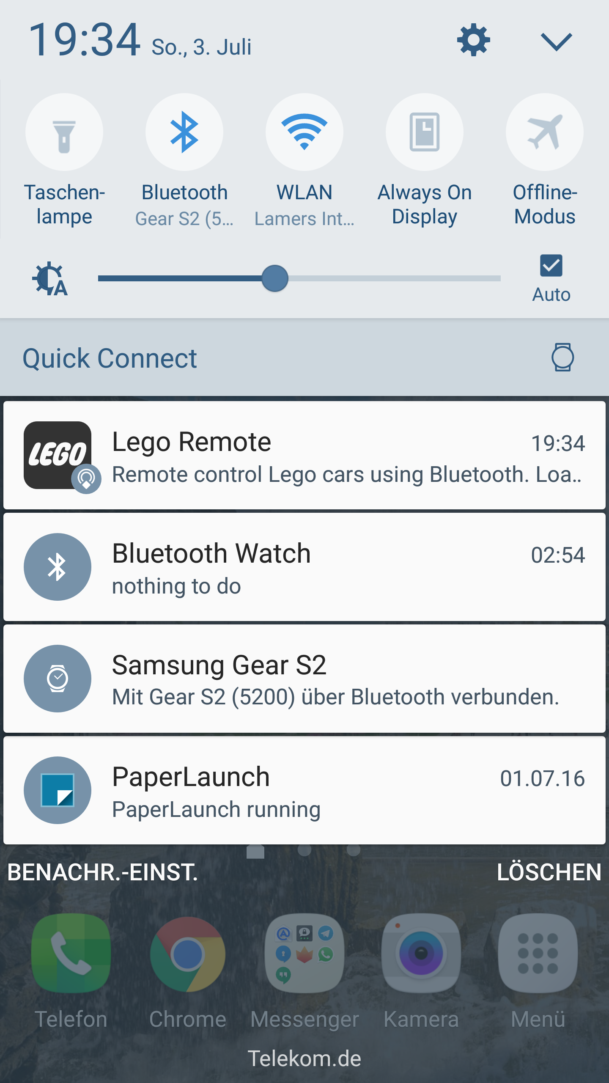
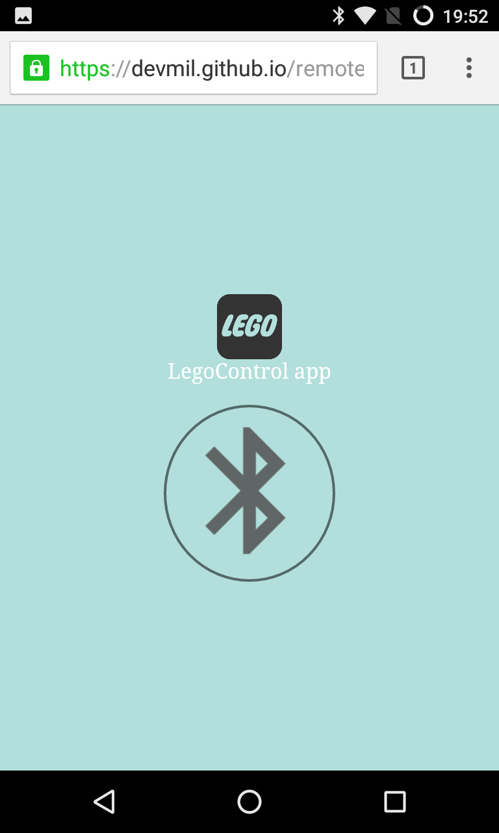
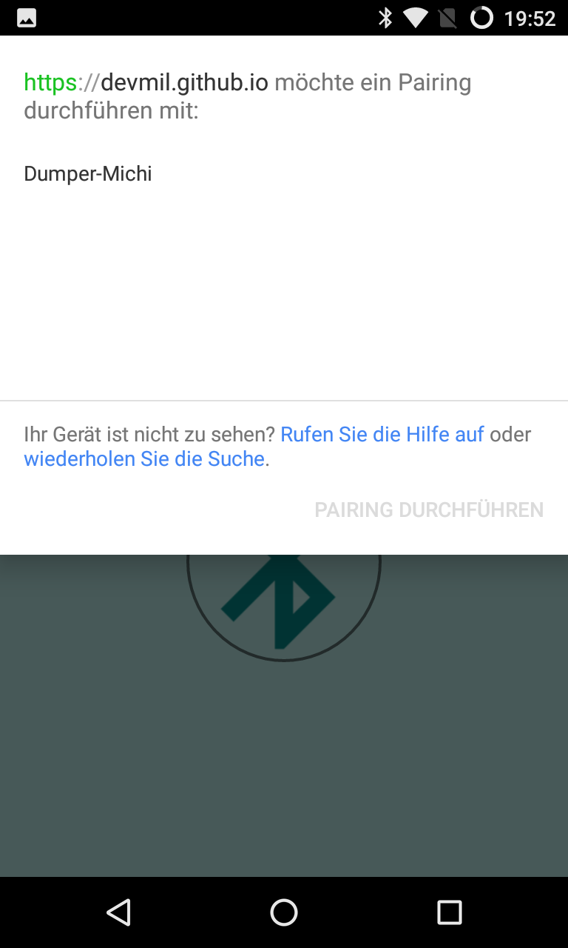
Smartphone UX
RC Lego Car Project - Remote control

Slide 20
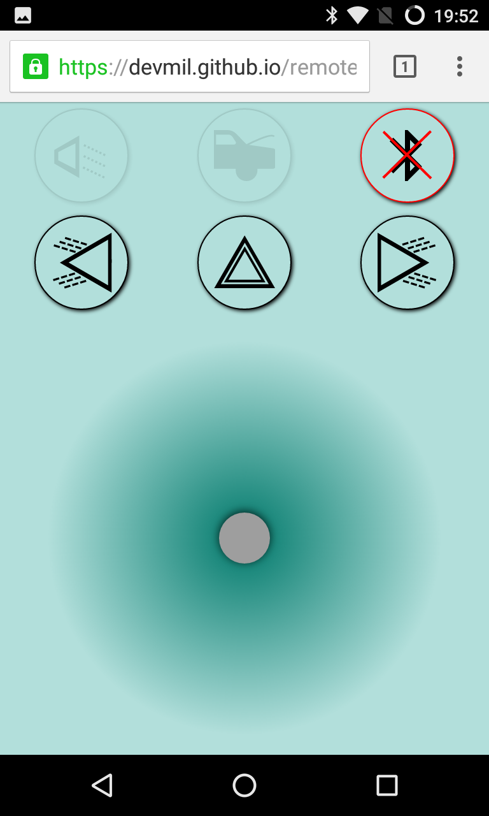
WebApp
RC Lego Car Project - Remote control
Typescript
AngularJS 2
Connects to the Lego control service (via UID)
Writes data to characteristics:
SpeedCharacteristic
SteeringCharacteristic
TrunkCharacteristic
FrontLightCharacteristic
BlinkCharacteristic

Slide 21
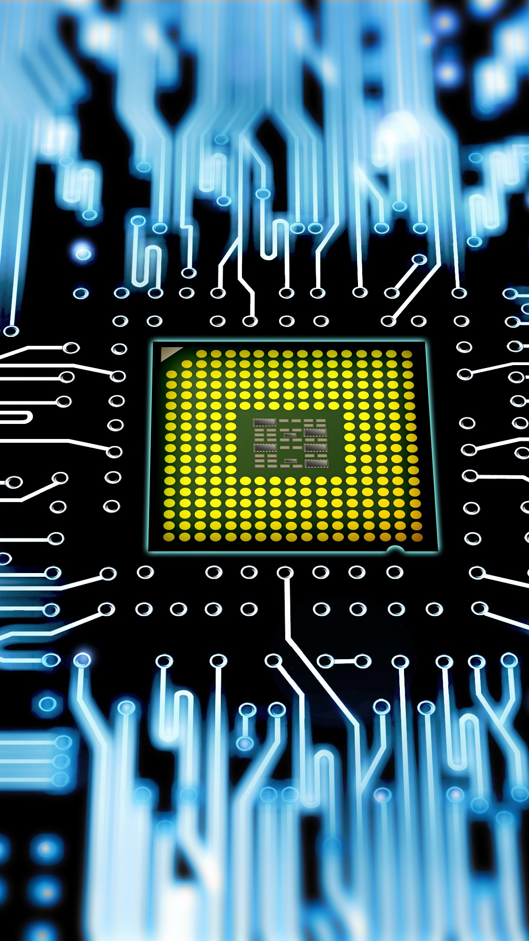
Car electronics
RC Lego Car Project

Slide 22
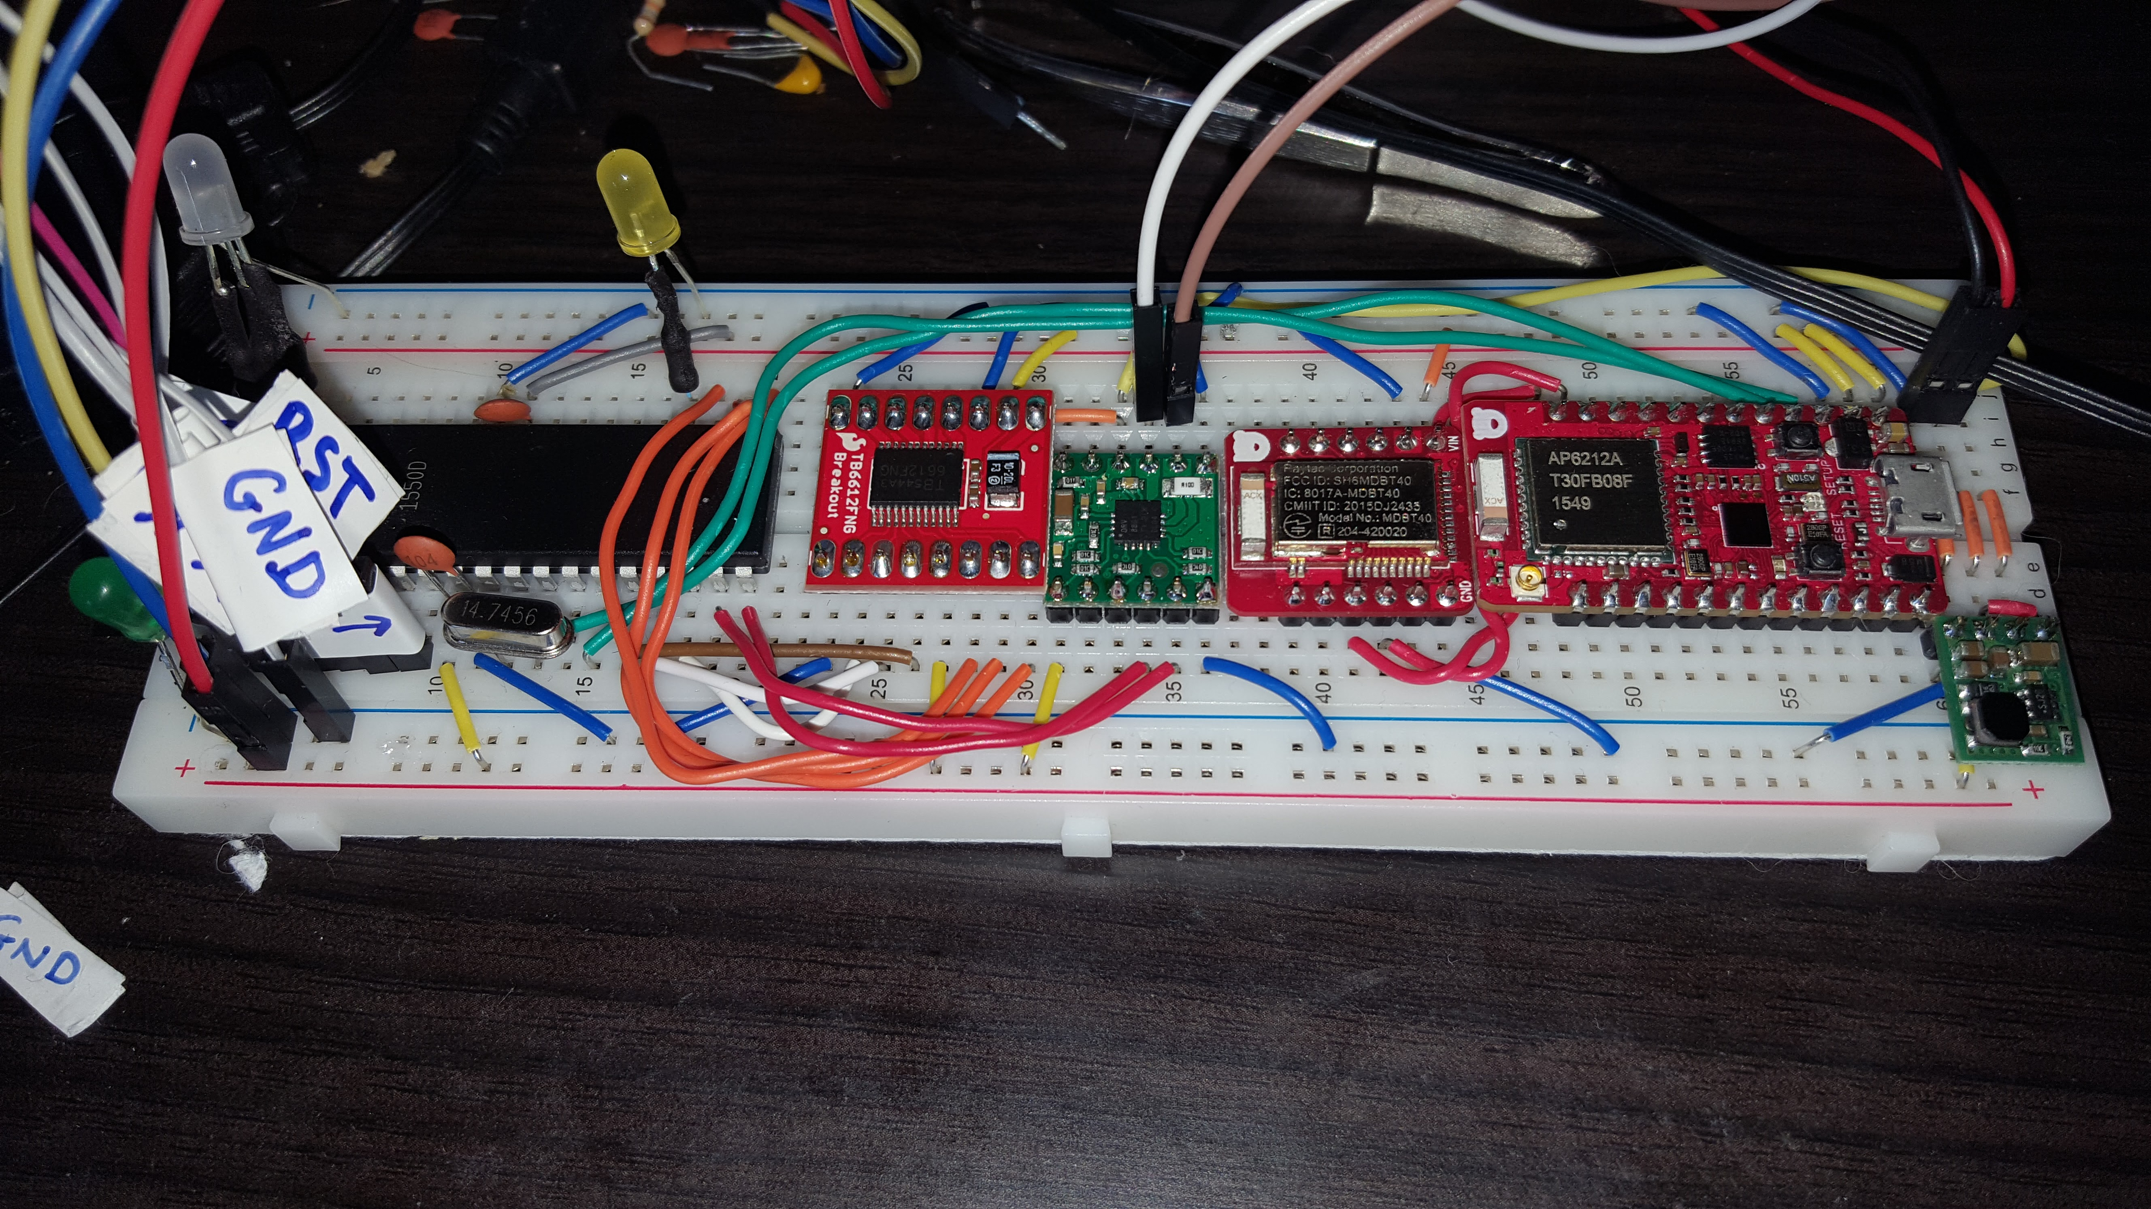
Test setup
RC Lego Car project - Electronics

Slide 23
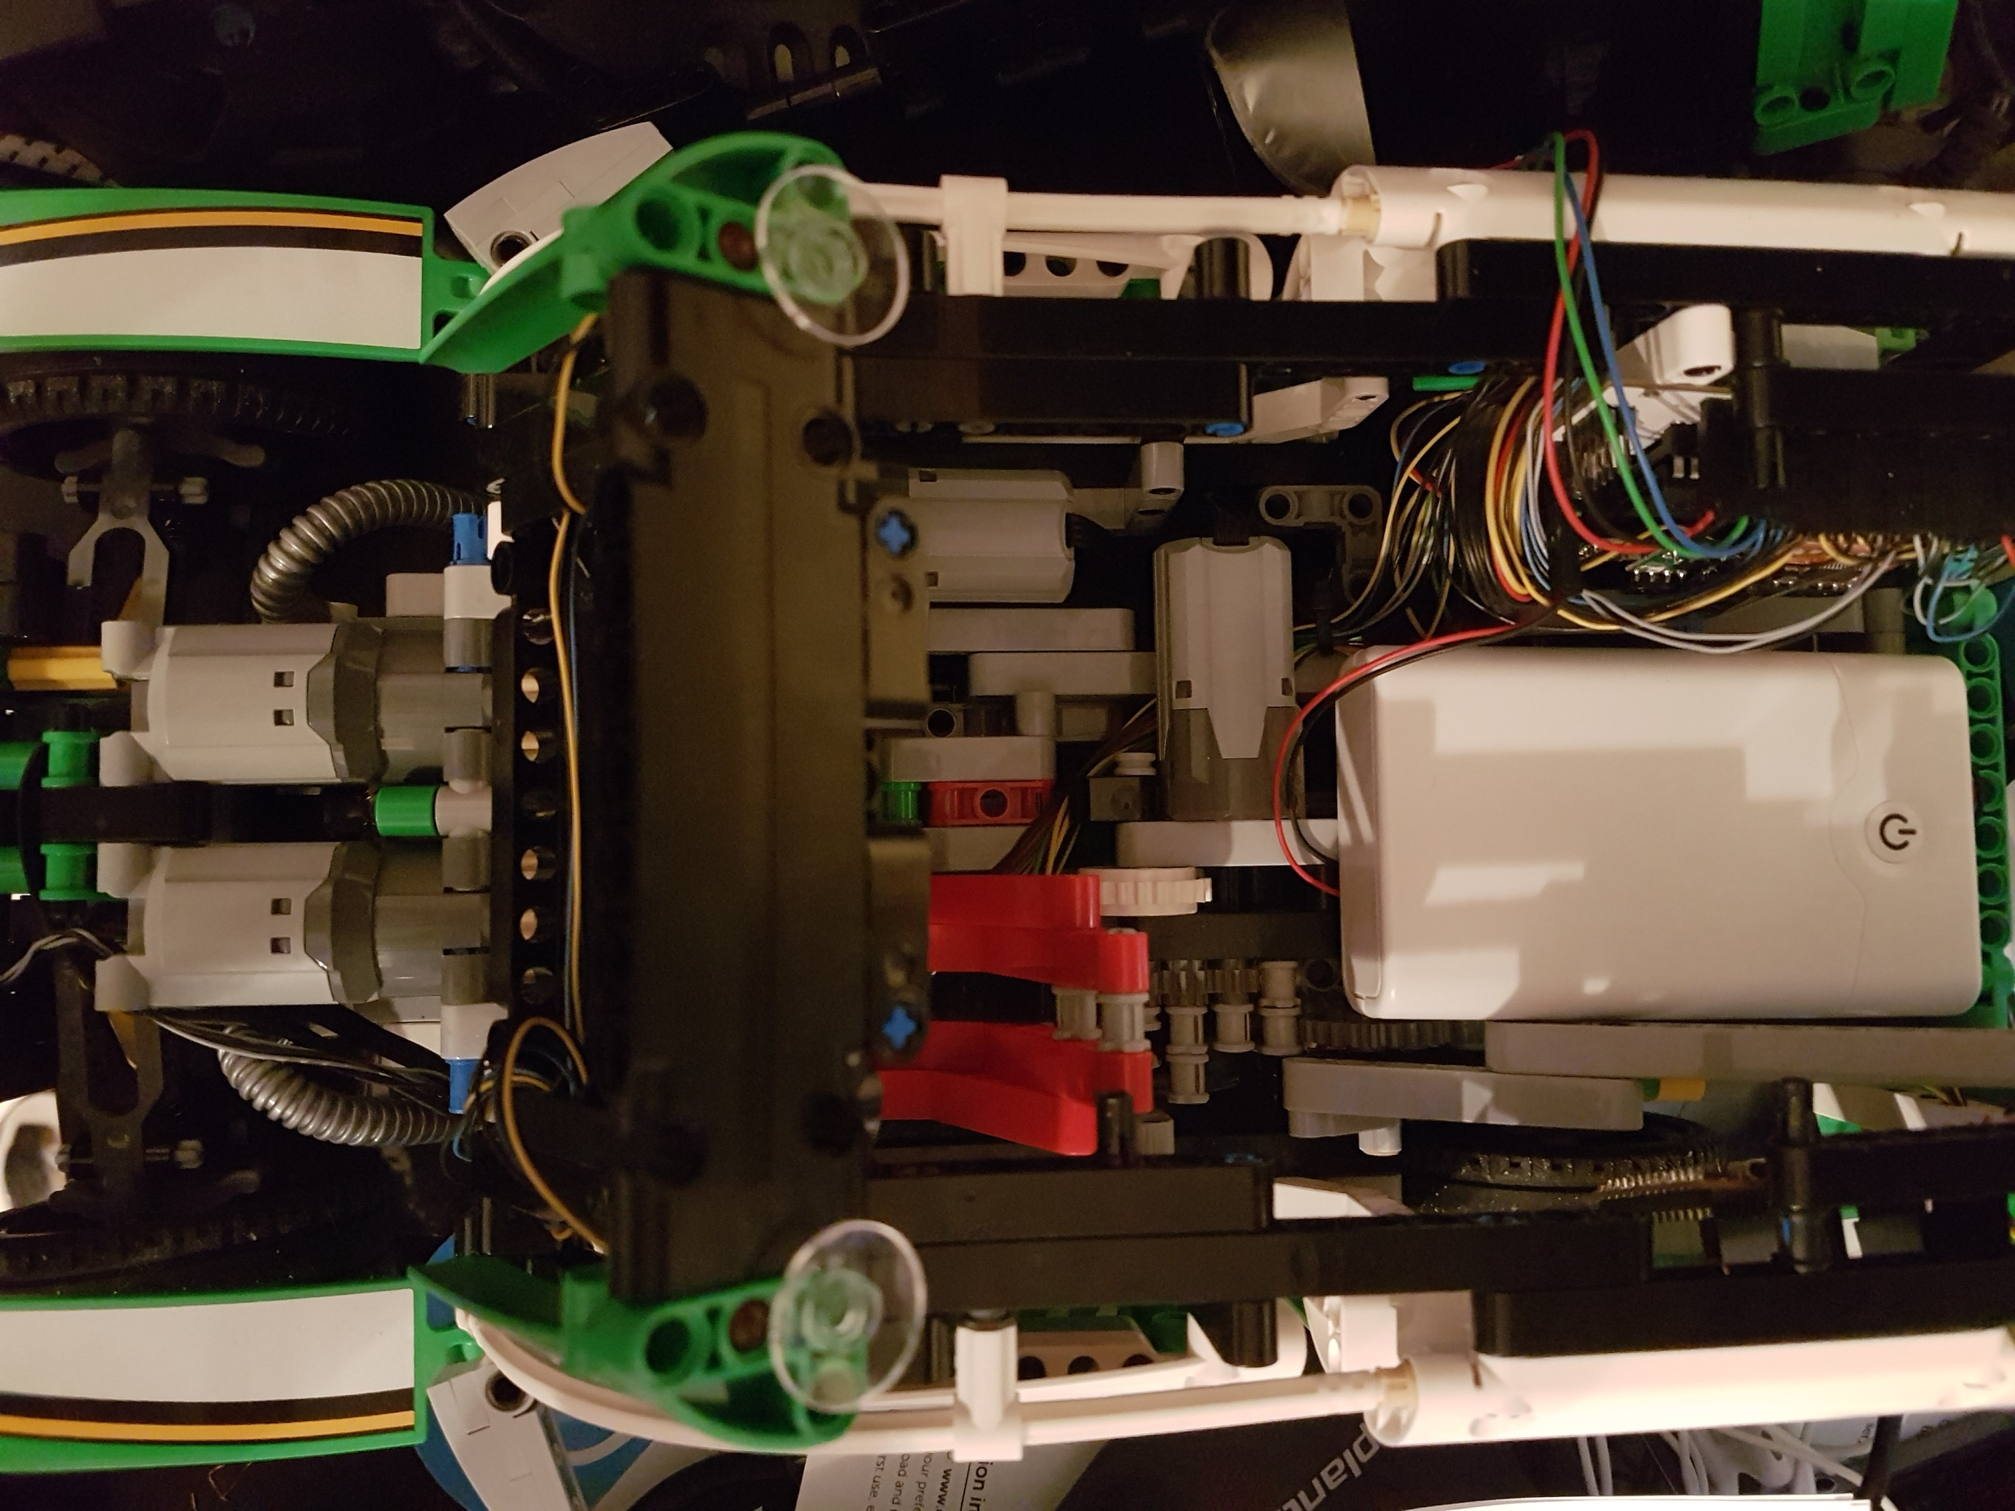

Architecture
RC Lego Car project - Electronics
Mainboard
<<PWM>>
Motors
<<Serial commands>>
<<BT Characteristics>>
Control board

Slide 24

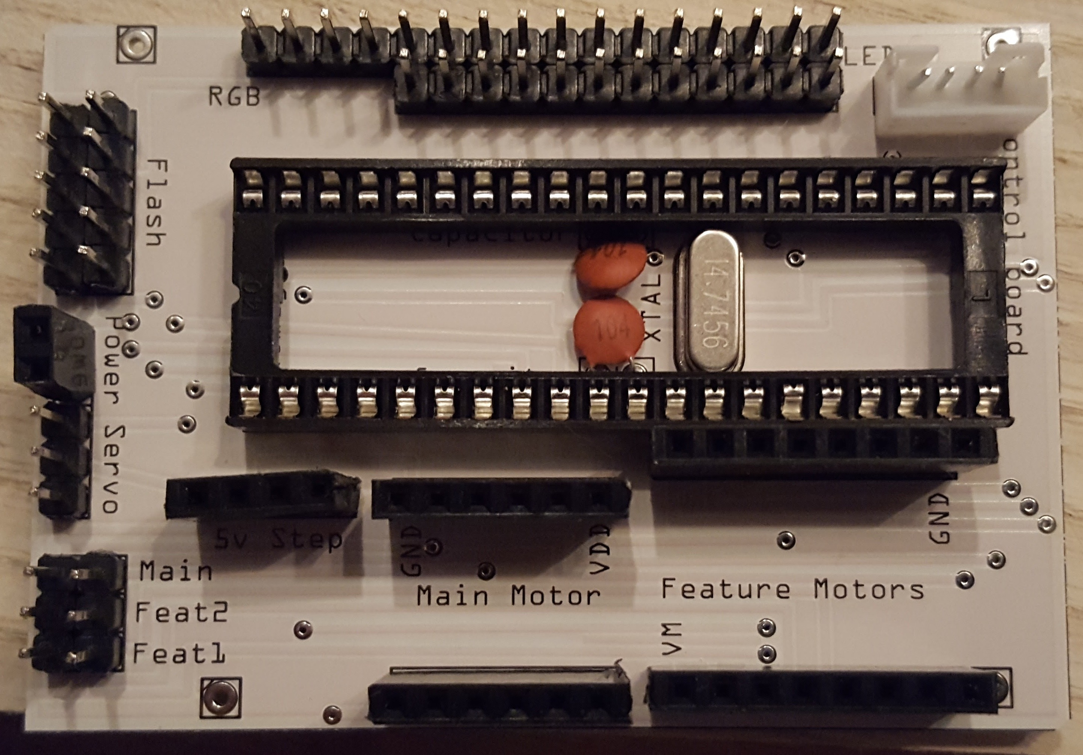
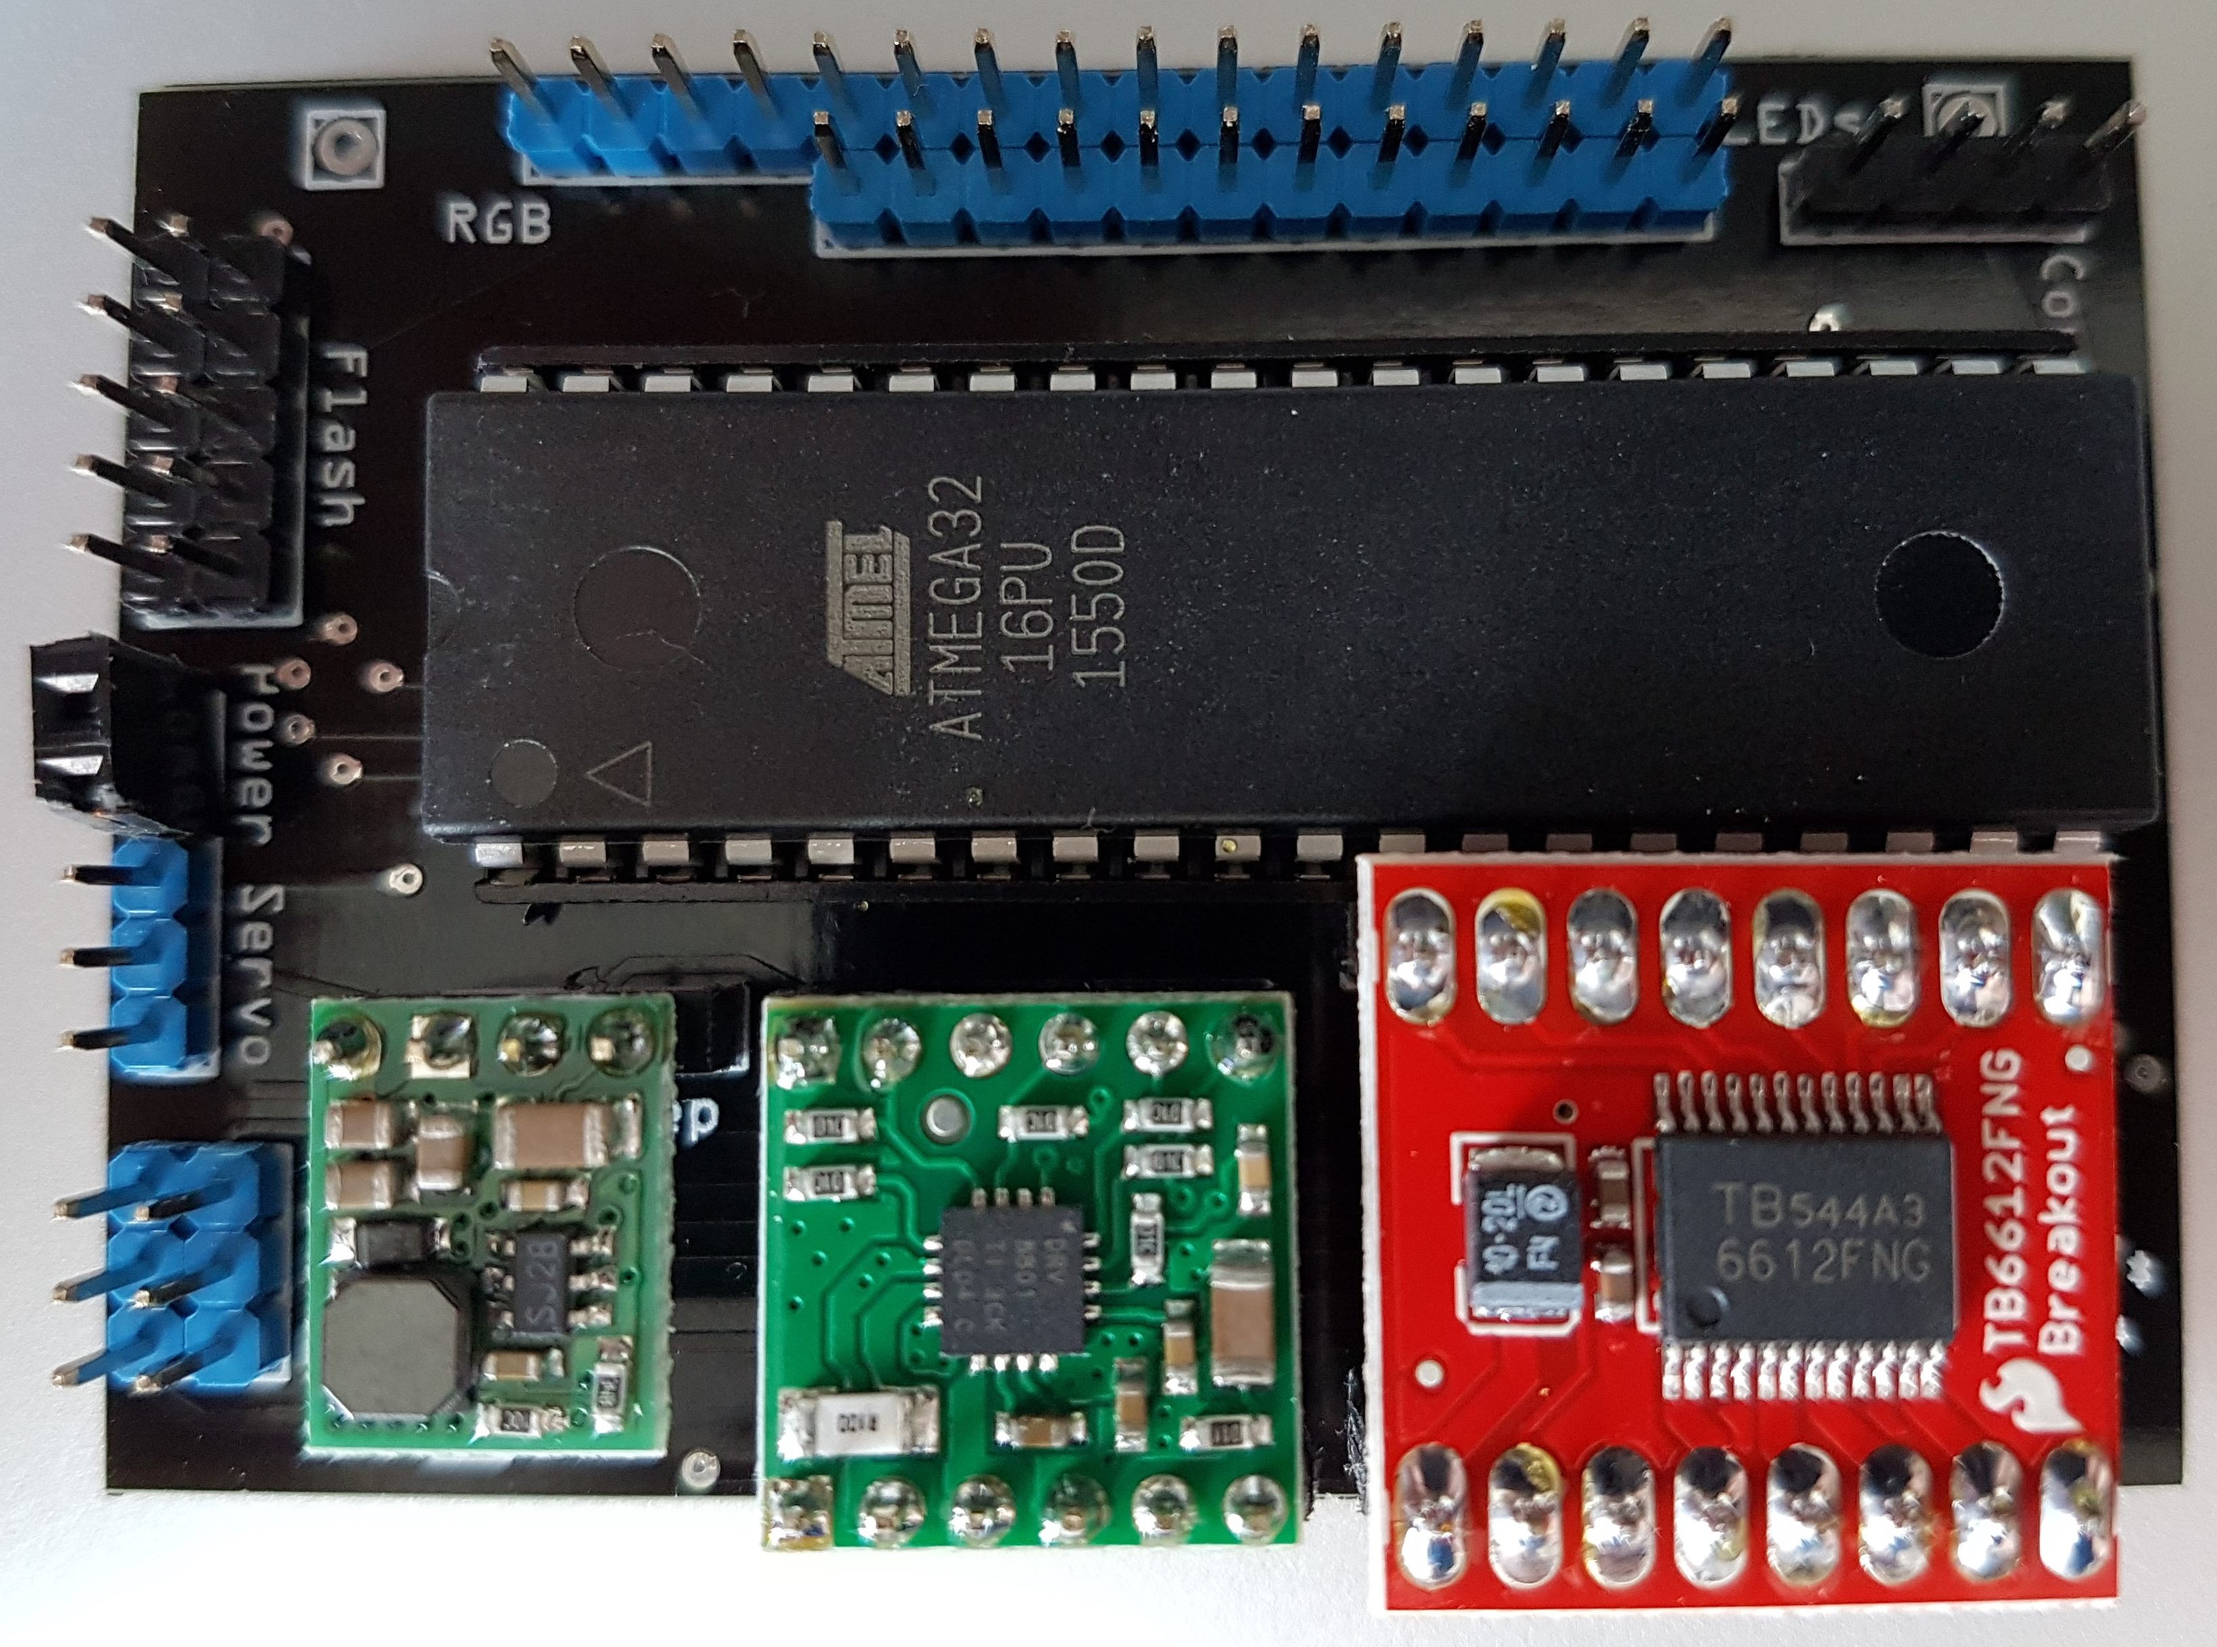
Mainboard
RC Lego Car project - Electronics
Hardware control
No car specific logic
Timer for PWM signals
Parts:
ATMega32
5V Step down regulator
H bridges (single for main motor, dual for feature motors)
Receives commands via UART from control board

Slide 25
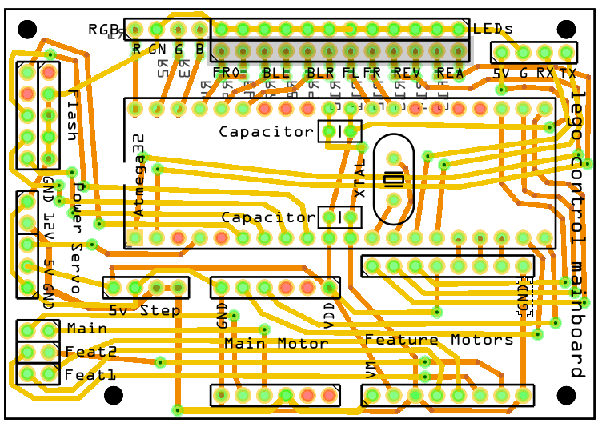
Mainboard Circuit
RC Lego Car project - Electronics

Slide 26
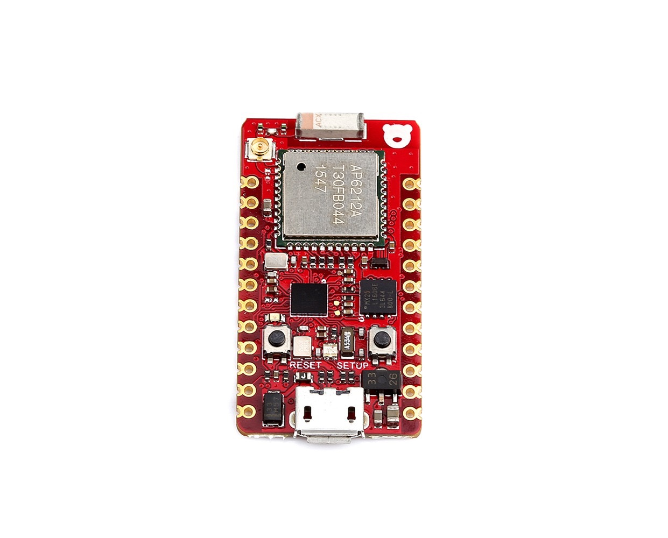

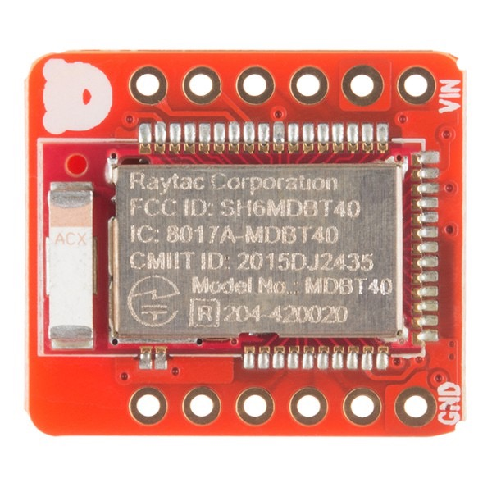
Control Board
RC Lego Car project - Electronics
Provides the BT service
Contains the car logic
what does „open trunk“ mean?
Blink control (sends LED on/off to the mainboard, controls the timings itself)
has a car specific profile
Maximum steering angles
is steering inverted?
is Trunk, Front light, Blinking, … supported?
Broadcasts the Eddystone telegram that contains the URL to the WebApp

Slide 27
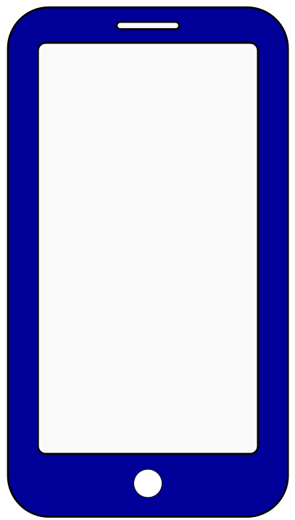
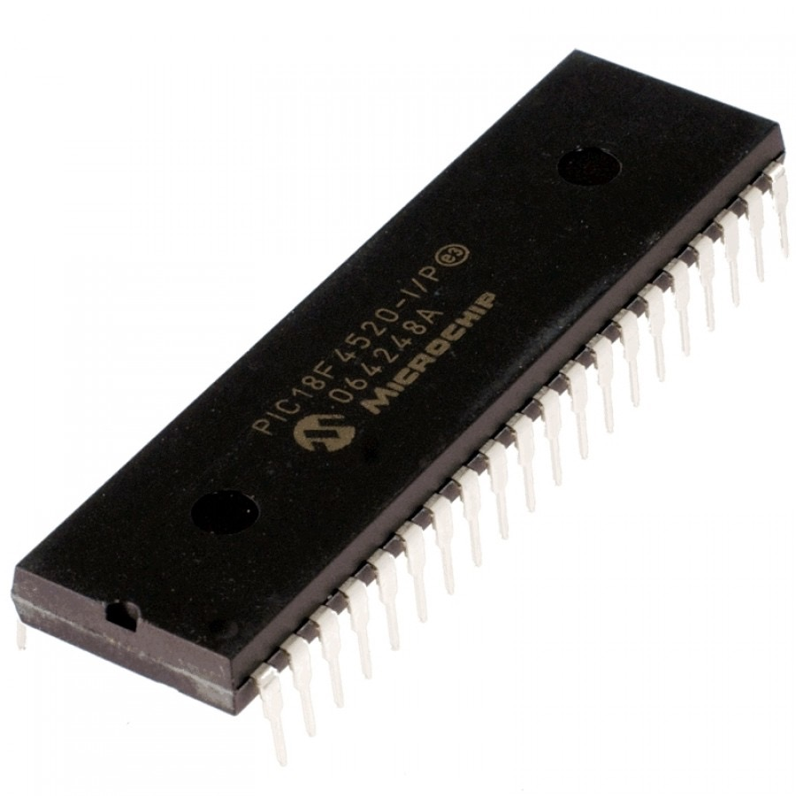
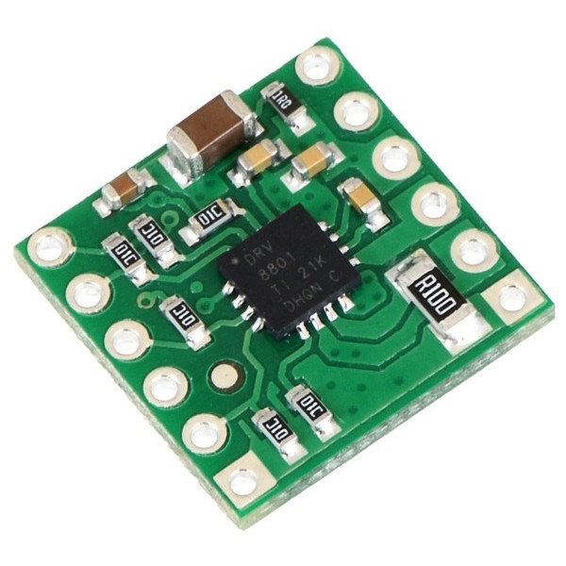
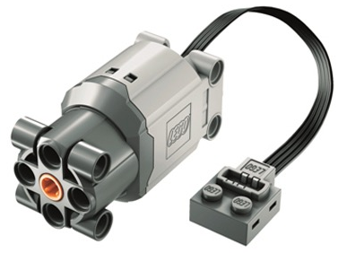
Information flow
RC Lego Car project - Electronics
SpeedCharacteristic
setValue(50)
SetMainMotorSpeed (50)
var data: Uint8Array = getBytesAction();
characteristic.writeValue(data);
50% PWM (5V)
SetMainMotorDirection (1)
50% PWM (12V)
Direction Pin High
AVRProtocol::send(
{
AVRCommandFactory::createMotorSpeedCommand(abs(percent)),
AVRCommandFactory::createMotorDirectionCommand(percent > 0)
});
50% PWM (12V)
float value = (motor->timerMax * percent) / 100;
*motor-> timerCounterRegister8 = (uint8_t)value;
Pin_setValue(&motor-> pinDirection1, directionVal);
\cms=50|md=1/

Slide 28
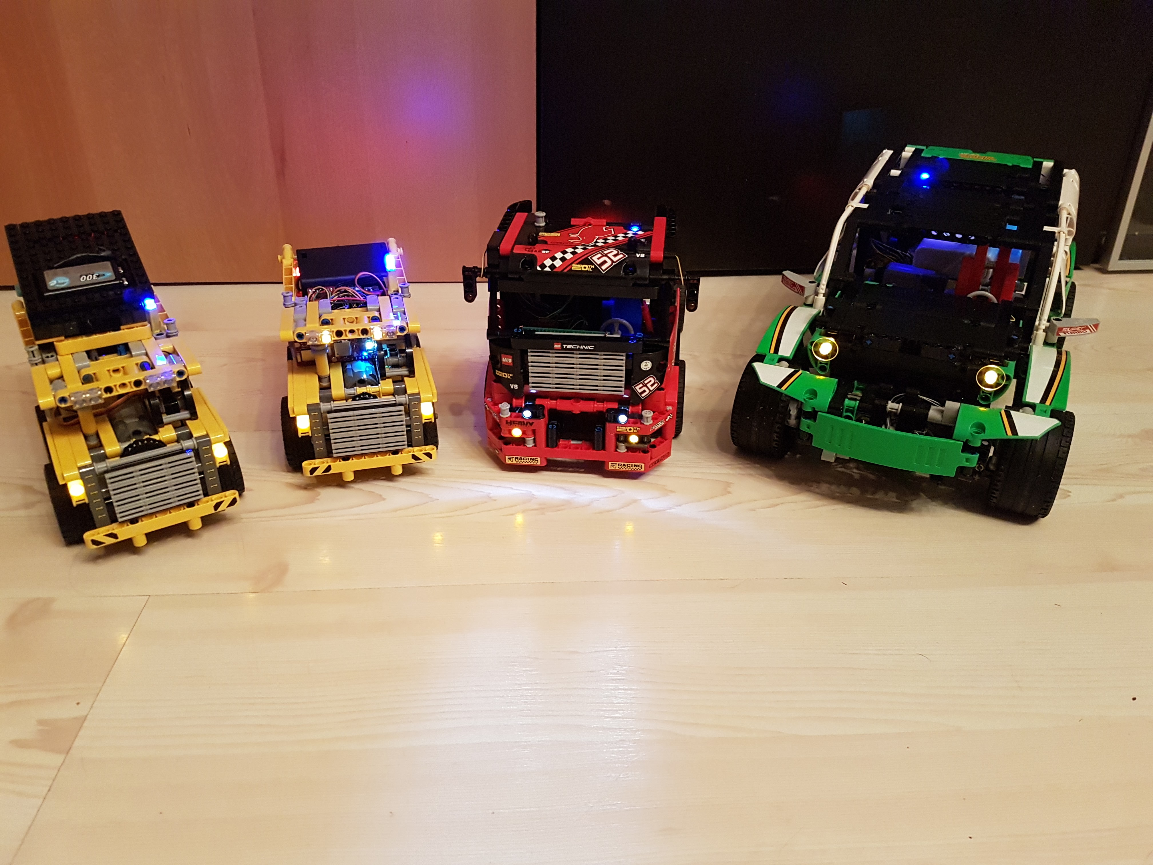
Demo
RC Lego Car Project

Slide 29
Sources
RC Lego Car project - Sources
Wikipedia
Bluetooth: https://de.wikipedia.org/wiki/Bluetooth
BLE: https://de.wikipedia.org/wiki/Bluetooth_Low_Energy
Bluetooth developer
GATT: https://developer.bluetooth.org/TechnologyOverview/Pages/GATT.aspx
Physical Web
https://google.github.io/physical-web/

Slide 30
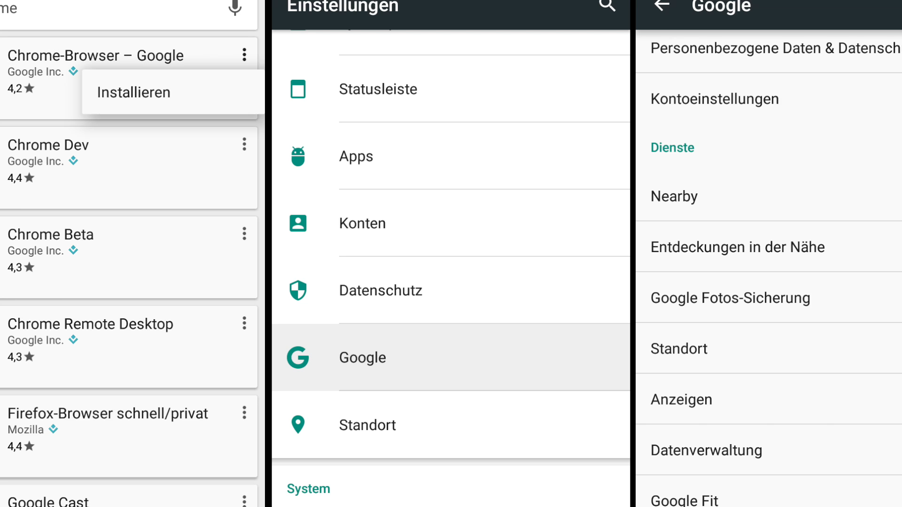
Setup (Android 6.0, Chrome)
RC Lego Car project - Setup

